Slide 1
RÉsumÉ and cover letter workshop
Christian James Barimbao
January 30, 2024
Video and Image Processing Laboratory
Notes:
Also include a brief discussion between the difference of a Resume and a CV.

Slide 2
Objective
The goal of your résumé is to pass Applicant Tracking Systems and gain an interview from the Hiring Manager.
The objective of this workshop is to create an engaging résumé and a supporting Cover Letter tailored to a particular job post.

Slide 3
Outline
Part 1 – Organizing your Résumé
Résumé style
Deciding on Length and Content
Hands-on activity
Part 2 – Writing your Cover Letter

Slide 4
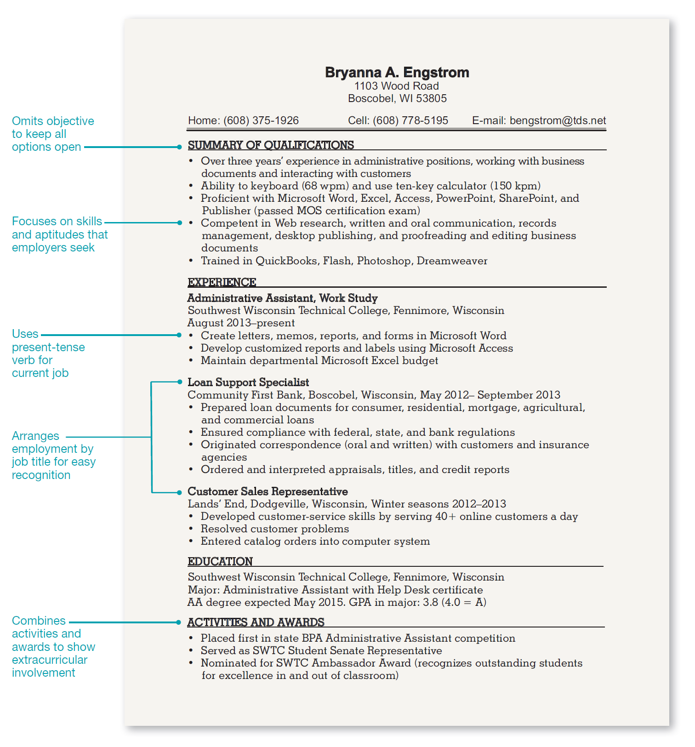
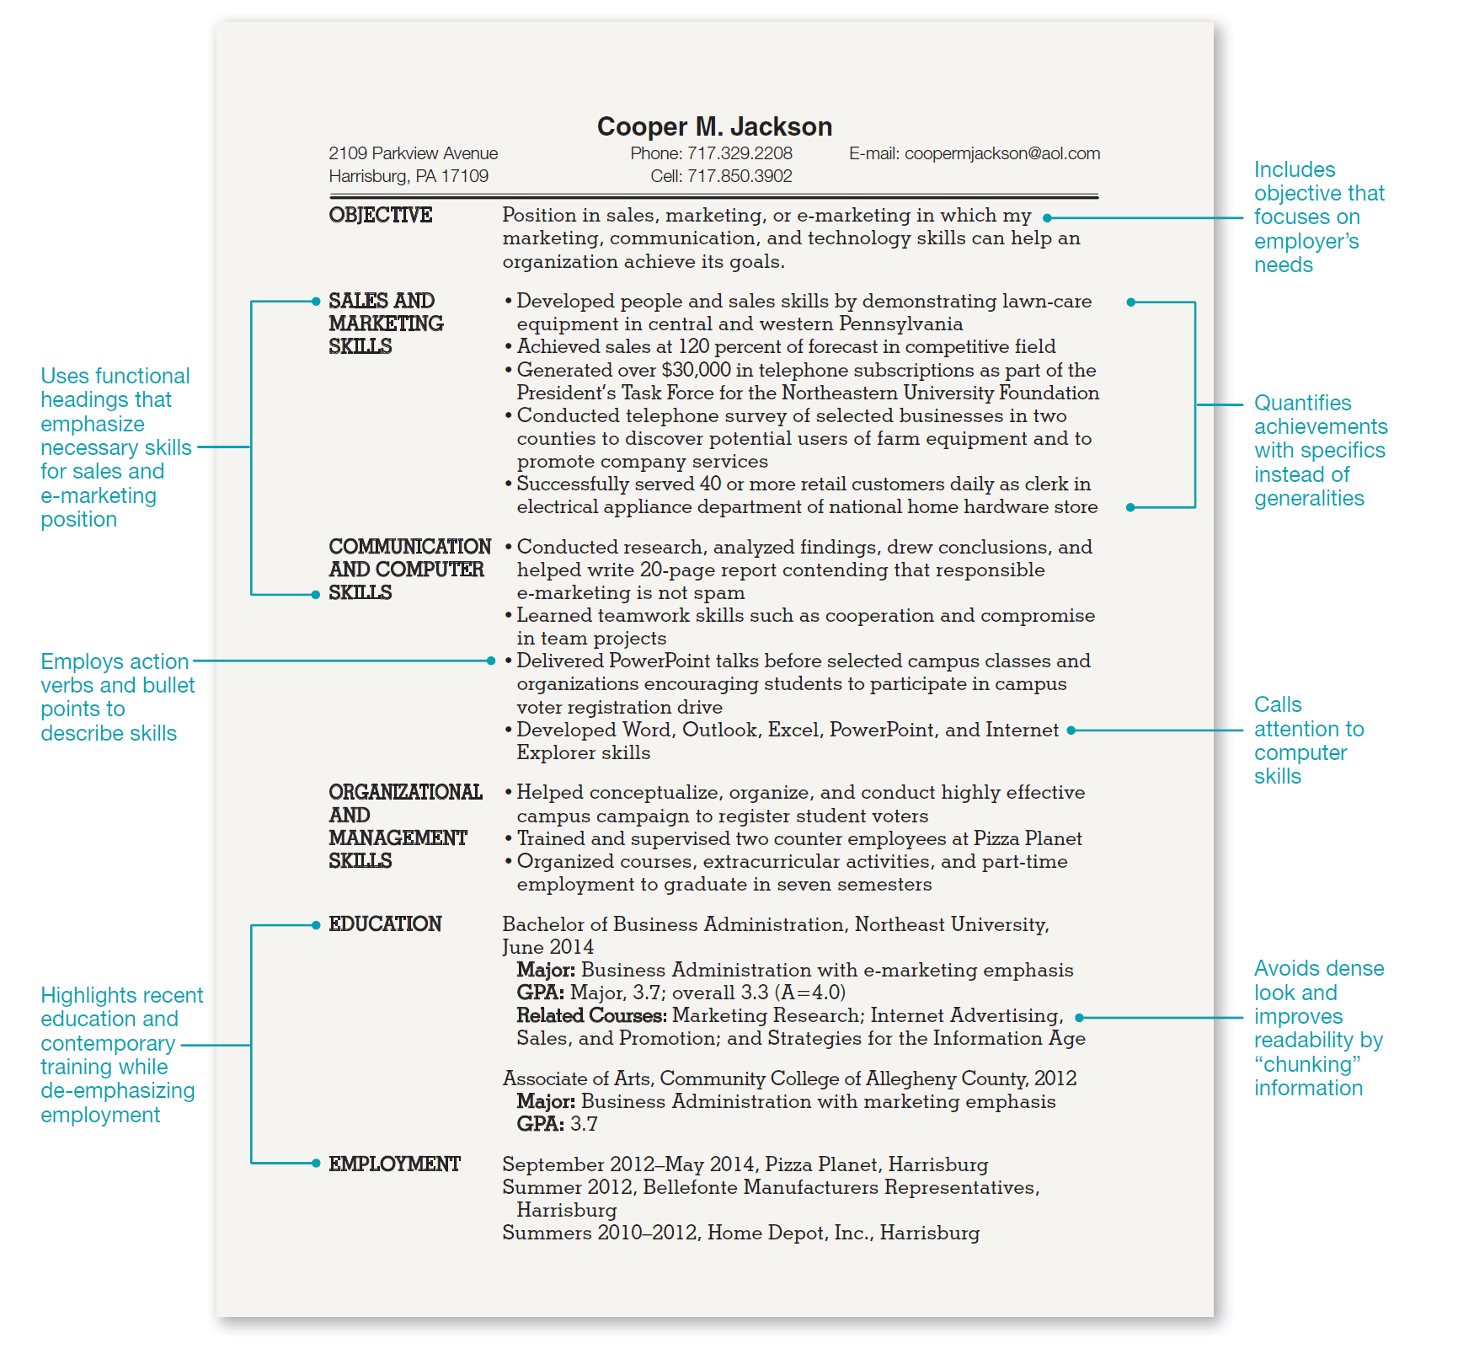
Résumé style
Chronological
Functional
Notes:
Chronological – Recent graduate with
Functional – Recent graduate with unrelated part-time experience

Slide 5
Résumé style
Chronological
Functional
Notes:
Chronological – Student seeking internship
Functional – Recent graduate with unrelated part-time experience

Slide 6
Every résumé should be tailored for every job application
Unrelated job postings will each require a separate résumé

Slide 7
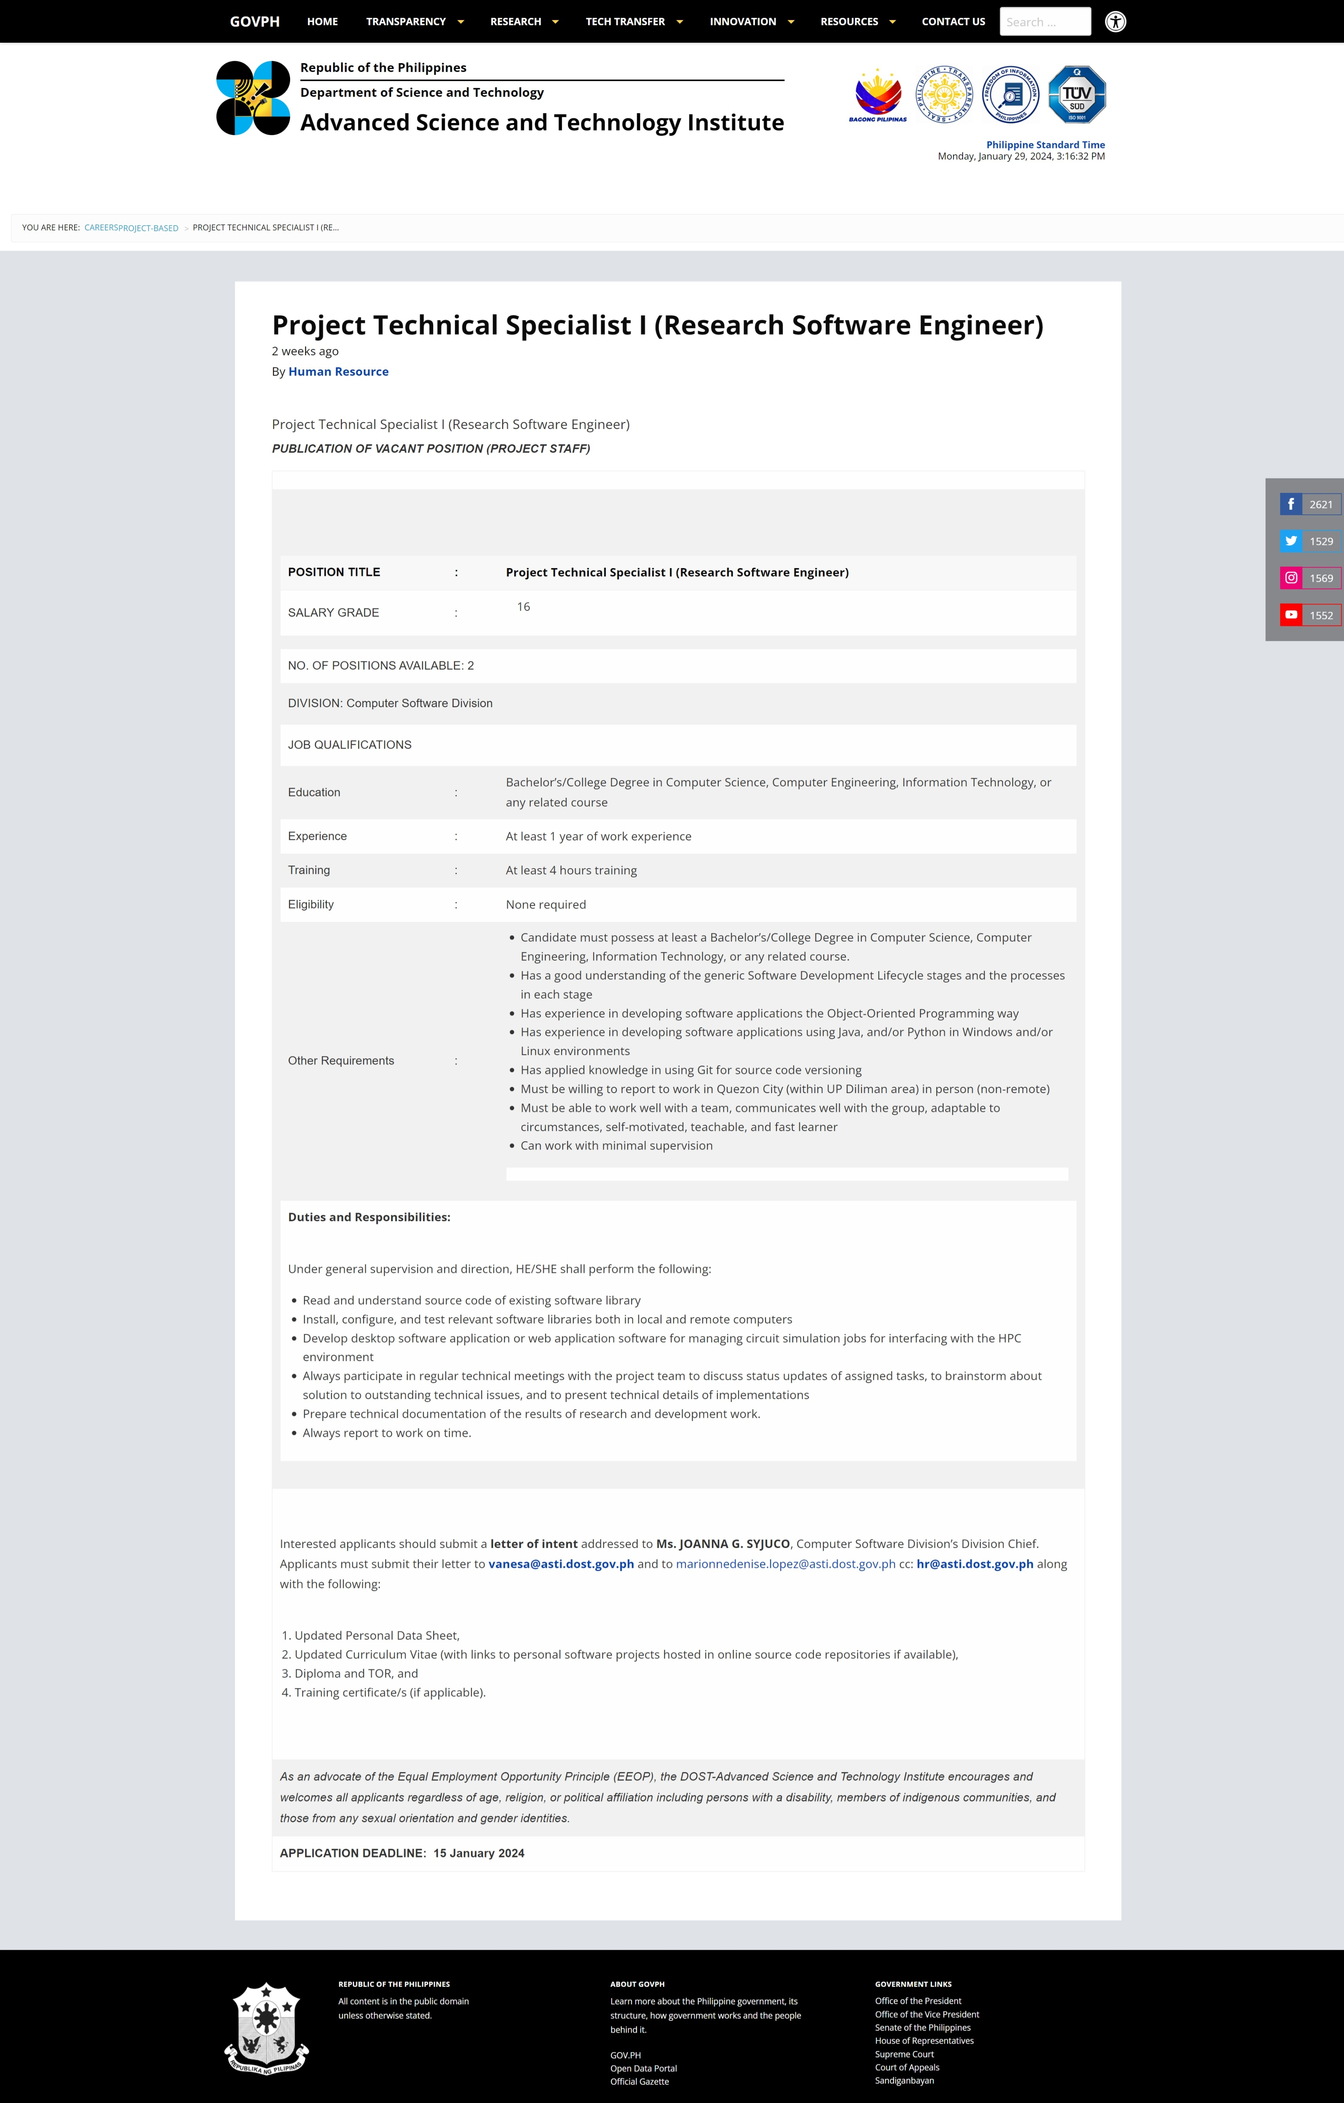

Slide 8
Job description
Quantify achievements
Use action words

Slide 9
LONG-TERM VS. SHORT-TERM

Slide 10
GLOBAL CURRENCY MARKETS
 | $USD | £EUR | ¥JPY | ₿BTC
Q1 | 4.5 | 2.3 | 1.7 | 5.0
Q2 | 3.2 | 5.1 | 4.4 | 3.0
Q3 | 2.1 | 1.7 | 2.5 | 2.8
Q4 | 4.5 | 2.2 | 1.7 | 7.0

Slide 11
SUMMARY
At Krypto Logics, we believe in giving 110%. By using our next-generation data architecture, we help investors virtually manage their portfolios. We thrive because of our market knowledge and great team. As our CEO says, "Efficiencies will come from proactively transforming how we do business."

Slide 12
THANK YOU
References consulted:
Guffey, M.E. and Leowy D., Essentials of Business Communication 12e, 10e
Ancheta, M.R., English 30 Course Materials 1sAY2022-2023 (UPD DECL)
https://owl.purdue.edu/owl/job_search_writing

